Slide 1
N E U R A L N E T W O R K S
Mohamed A. El-Sharkawi
The CIA Lab
Department of Electrical Engineering
University of Washington
Seattle, WA 98195
elsharkawi@ee.washington.edu
http://cialab.ee.washington.edu

Slide 2
General Applications of NN
Classification
Regression
Combinatorial optimization
M. A. El-Sharkawi, NN-General

Slide 3
Introduction to Classification
M. A. El-Sharkawi, NN-General

Slide 4
2-Class Linear Classifier
  X ₂
  X ₂
  X ₁
Decision Surface
M. A. El-Sharkawi, NN-General

Slide 5
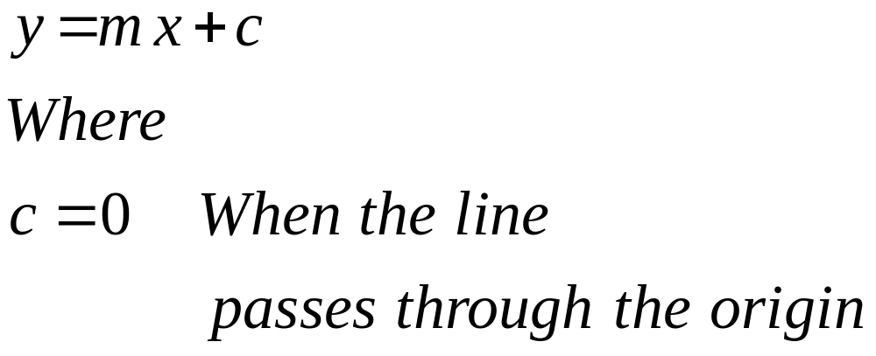
Linear Decision Surface
M. A. El-Sharkawi, NN-General

Slide 6
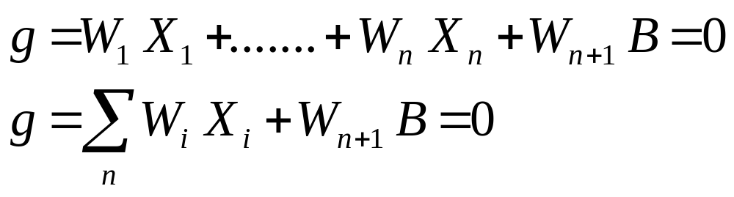
General Linear Decision Surface for 2-Class Classifier
W is a weight
B is a bias
M. A. El-Sharkawi, NN-General

Slide 7
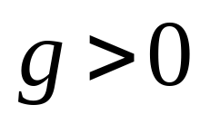
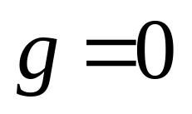
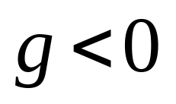
  X ₂
  X ₂
  X ₁
M. A. El-Sharkawi, NN-General

Slide 8
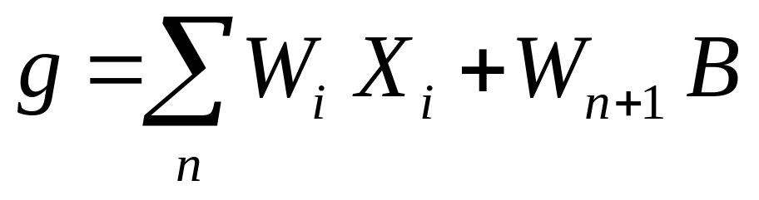
g
Σ
Decision Surface is at g=0
w₁
w₂
w₄
w₃
X₁
X₂
X₃
B
M. A. El-Sharkawi, NN-General

Slide 9
General Multi-Class decision Surfaces
M. A. El-Sharkawi, NN-General

Slide 10
  X ₂
g₂=0
g₁=0
g₃=0
  X ₁
M. A. El-Sharkawi, NN-General

Slide 11
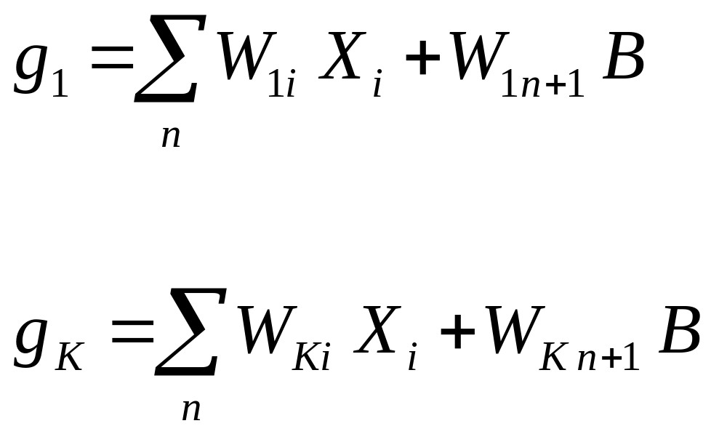
M. A. El-Sharkawi, NN-General

Slide 12
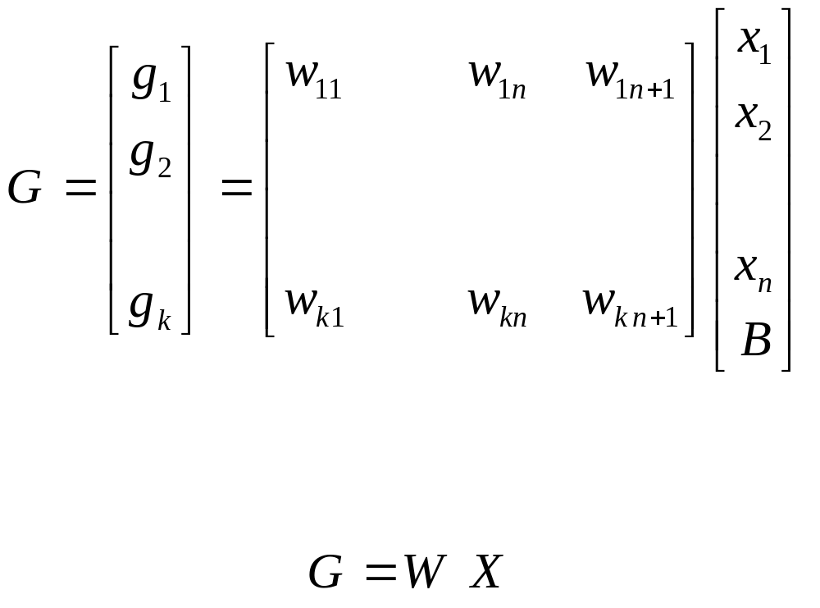
M. A. El-Sharkawi, NN-General

Slide 13
g₁
g_{K}
Σ
Σ
w_{K1}
w₁₄
w₁₁
w₁₃
w_{K2}
w_{K3}
w_{K4}
w₁₂
X₁
X₂
X₃
B
M. A. El-Sharkawi, NN-General

Slide 14
Class Table (selector)
g₁ | g₂ | g₃ | Class
>0 | >0 | >0 | 1
>0 | >0 | <0 | 2
>0 | >0 | >0 | k
M. A. El-Sharkawi, NN-General

Slide 15
Class
Selector
g₁
g_{K}
Σ
Σ
w_{K1}
w₁₄
w₁₁
w₁₃
w_{K3}
w_{K2}
w₁₂
w_{K4}
X₁
X₂
X₃
B
M. A. El-Sharkawi, NN-General

Slide 16
Non-linear Classifier
  X ₂
  X ₁
Decision Surface
M. A. El-Sharkawi, NN-General

Slide 17
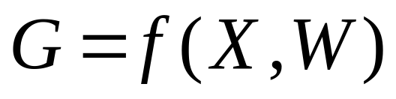
g₁
g_{K}
f
f
f is a
nonlinear
function
w_{K1}
w₁₄
w₁₁
w₁₃
w_{K2}
w_{K3}
w_{K4}
w₁₂
X₁
X₂
X₃
B
M. A. El-Sharkawi, NN-General

Slide 18
Introduction to Regression
M. A. El-Sharkawi, NN-General

Slide 19
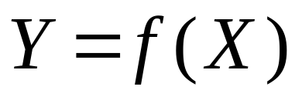
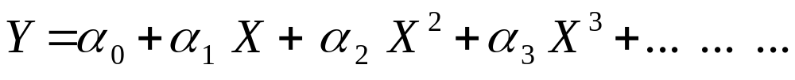
Regression Expansion
  Y
  X
M. A. El-Sharkawi, NN-General

Slide 20
Regression Expansion
  Y
Y_{k}
  X
X_{k}
M. A. El-Sharkawi, NN-General

Slide 21
g₁
g_{K}
f
f
Neuron
f is a
nonlinear
function
w_{K1}
w₁₄
w₁₁
w₁₃
w_{K2}
w_{K3}
w_{K4}
w₁₂
X₁
X₂
X₃
B
M. A. El-Sharkawi, NN-General

Slide 22
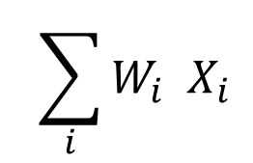
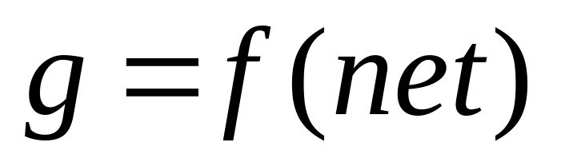
Neuron Structure
x
net
=
Σ
NET
f
g
M. A. El-Sharkawi, NN-General

Slide 23
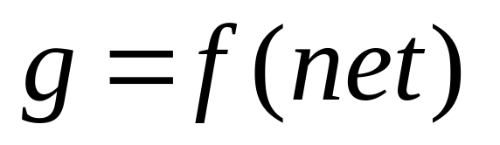
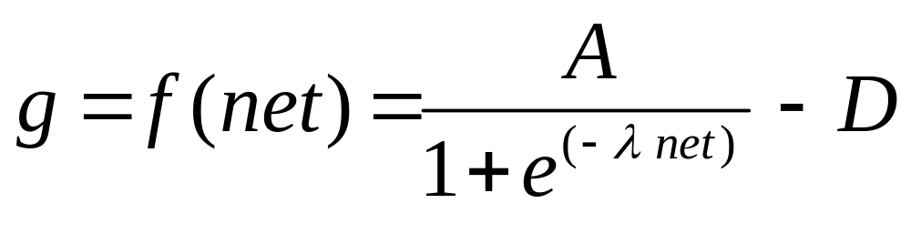
Activation Function
Sigmoidal Form of Activation Function
M. A. El-Sharkawi, NN-General

Slide 24
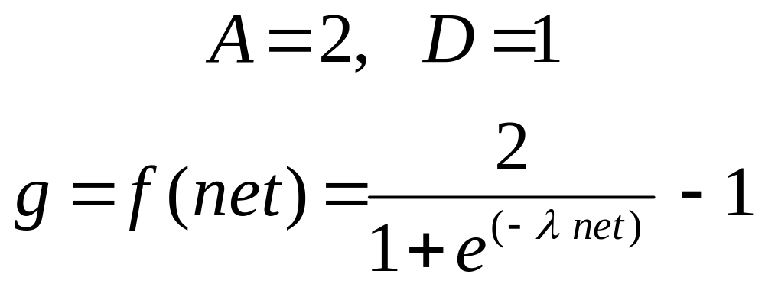
Bipolar Sigmoidal Function
M. A. El-Sharkawi, NN-General

Slide 25
  g
  1
λ₂> λ₁
λ₁
  net
M. A. El-Sharkawi, NN-General

Slide 26
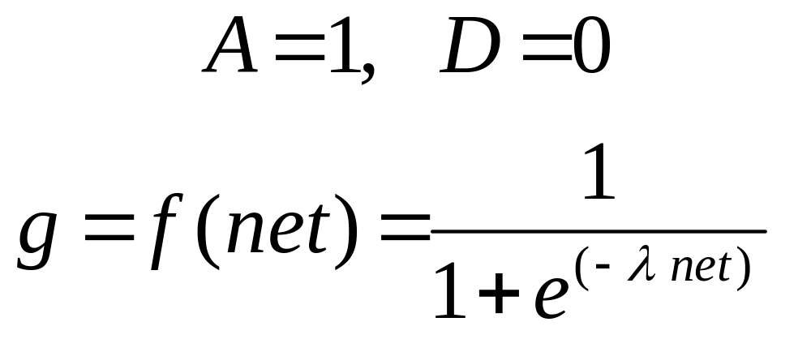
Unipolar Sigmoidal Function
M. A. El-Sharkawi, NN-General

Slide 27
  g
  1
λ₂> λ₁
λ₁
  1/2
  net
M. A. El-Sharkawi, NN-General

Slide 28
A Layered Perceptron
Connections
Input Patterns
Output Decision
Output layer
Hidden layer
Input layer
M. A. El-Sharkawi, NN-General

Slide 29
Neuron Structures
x
Pass through Neurons
x
x
x
Σ
Linear Neurons
Σ
f(.)
Nonlinear neurons
M. A. El-Sharkawi, NN-General

Slide 30
Typical Neuron Structure
x
Input Patterns
x
x
Σ
x
Σ
f(.)
Output Decision
M. A. El-Sharkawi, NN-General

Slide 31
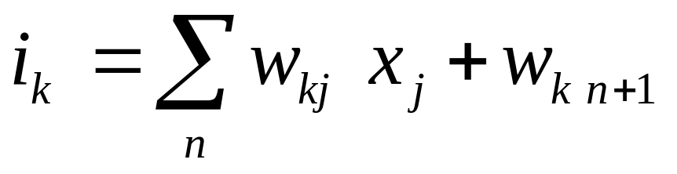
Signal Flow Between Layers
x₁
1
w_{k1}
1
k
w_{kn}
x_{n}
n
w_{k n+1}
Bias
n+1
1
Input to hidden neuron k (i_{k})
M. A. El-Sharkawi, NN-General

Slide 32
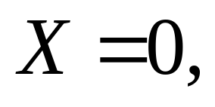
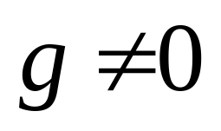
Why do we need bias?
Bias=1
x
Assume when
Σ
NET
f
g
M. A. El-Sharkawi, NN-General

Slide 33
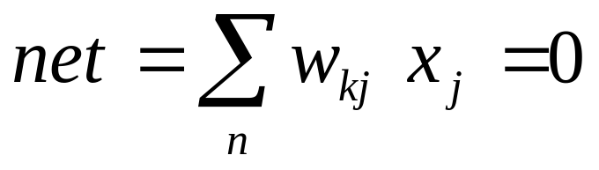
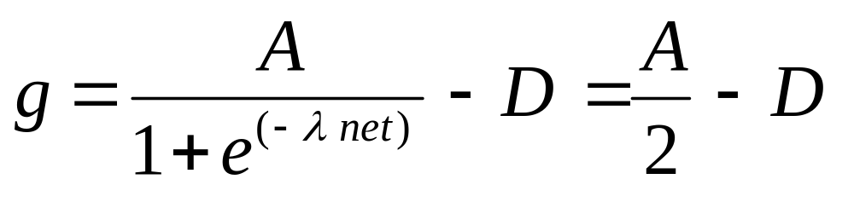
Without Bias
Bias=0
x
Σ
NET
A and D are fixed values.
f
Hence, g is also a fixed value and
may not reflect the correct magnitude
g
M. A. El-Sharkawi, NN-General

Slide 34
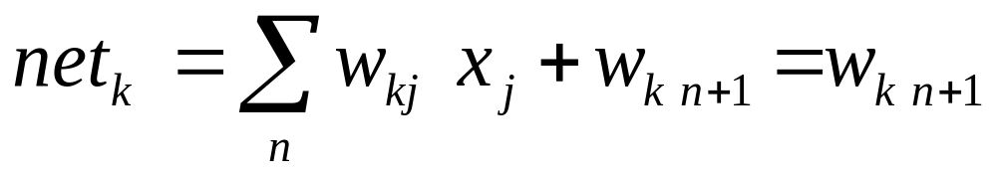
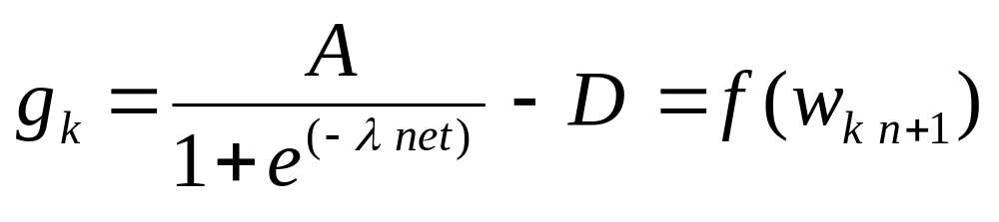
With Bias
Bias=1
x
Σ
NET
f
The value of g is determined by
the proper selection of w_{k n+1}
g_{k}
M. A. El-Sharkawi, NN-General

Slide 35
Example of NN Signal Flow
x₁
x₁
w₁₁
Σ
f
s₁
v₁₁
x₂
w₁₂
o
Σ
w₁₃
x₃
v₁₂
w₁₄
Σ
f
s₂
1
M. A. El-Sharkawi, NN-General

Slide 36
Objectives
Weights (w,v)
Output Decision (O)
Input patterns (I)
Compute the weights to obtain the desired
decision for the given input patterns
M. A. El-Sharkawi, NN-General

Slide 37
NN Learning
M. A. El-Sharkawi, NN-General

Slide 38
Training Techniques
Projected gradient descent
Random search
Genetic algorithms
Steepest Descent (error backpropagation)
Particle Swarms
… …
M. A. El-Sharkawi, NN-General

Slide 39
Error
Weights (w,v)
t₁
o₁
_
+
Input patterns (I)
e₁
_
e₂
o₂
+
t₂
o: NN output
t: Target (truth)
e: Error (t-o)
M. A. El-Sharkawi, NN-General

Slide 40
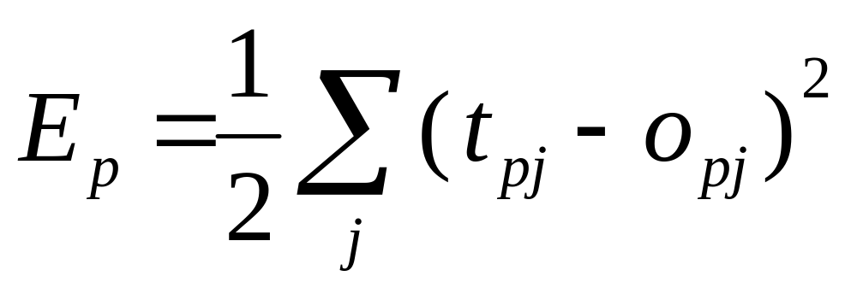
Error Function
E: Error function (least squares)
p: Pattern index
j : Index of output neuron
M. A. El-Sharkawi, NN-General

Slide 41
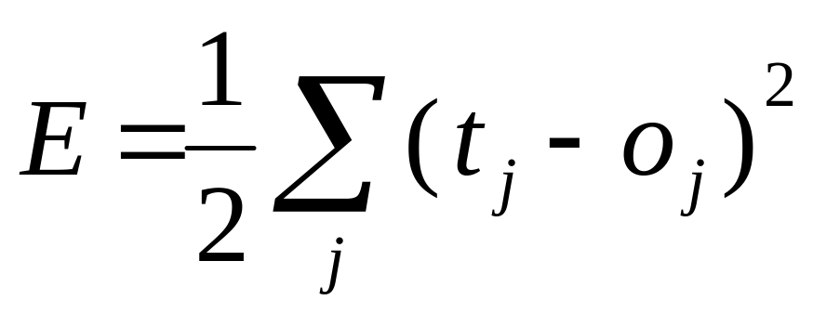
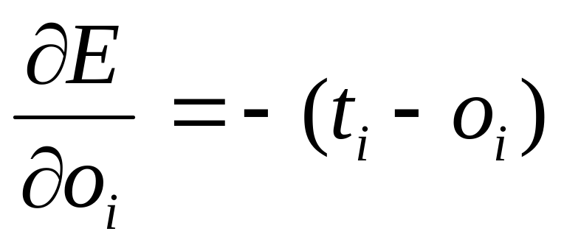
Steps of Error Backpropagation
Hidden-to-output neurons
Since
Hence
M. A. El-Sharkawi, NN-General

Slide 42
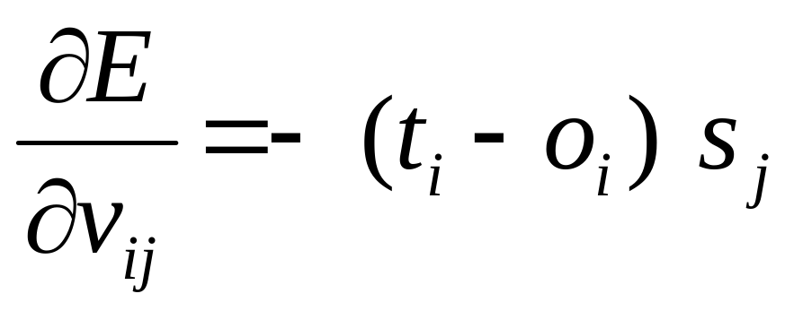
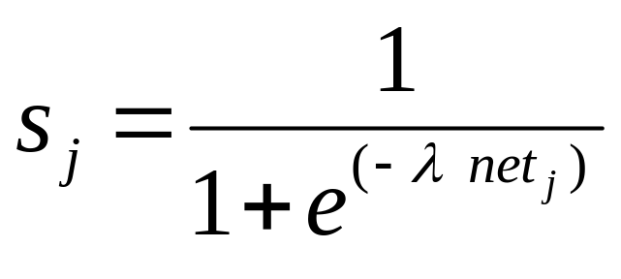
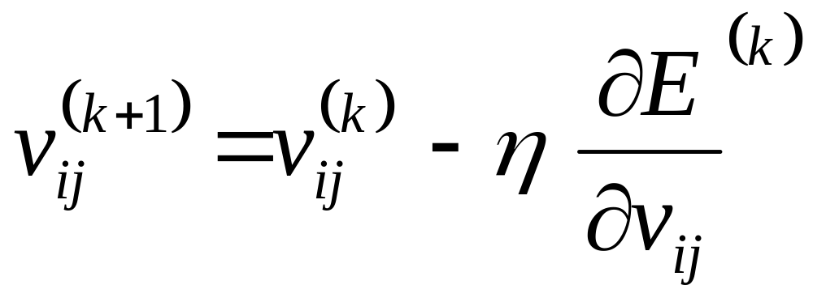
Steps of Error Backpropagation
Hidden-to-output neurons
M. A. El-Sharkawi, NN-General

Slide 43
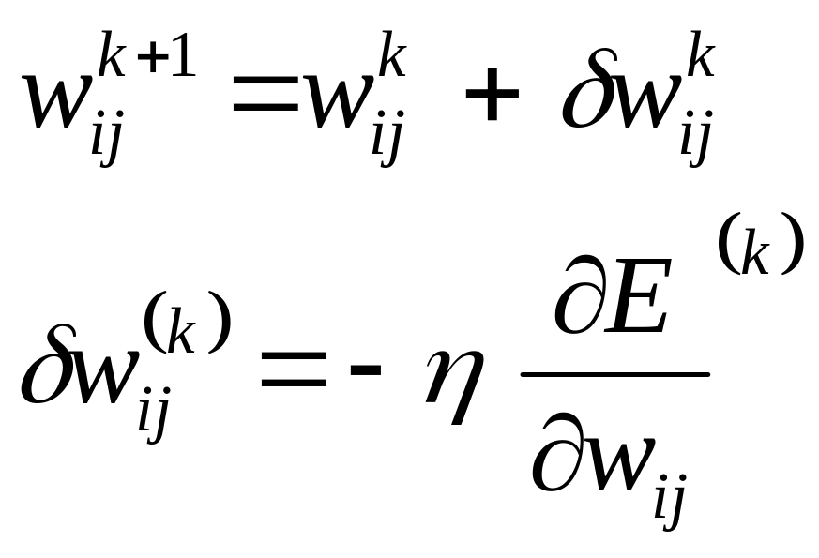
Delta rule (steepest Descent)
Input-to-hidden neurons
k: Iteration number
η: step size
M. A. El-Sharkawi, NN-General

Slide 44
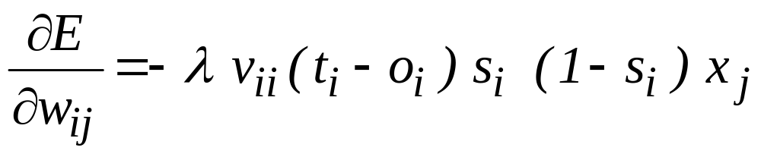
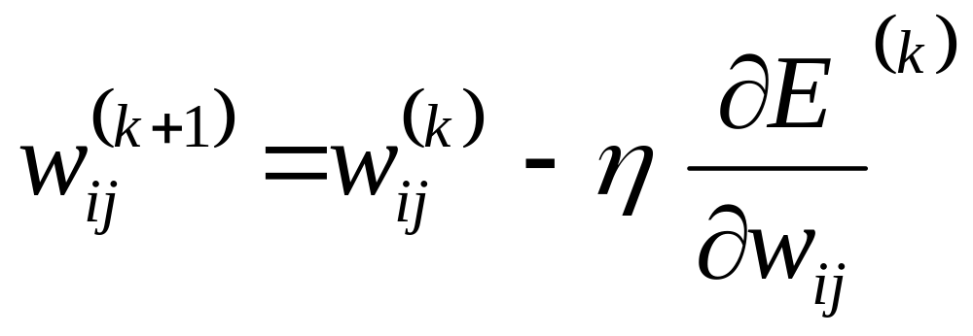
Steps of Error Backpropagation
Input-to-hidden neurons
M. A. El-Sharkawi, NN-General

Slide 45
Supervised vs Unsupervised Learning
X
X
NN
NN
O
_
T
E
+
Supervised
Unsupervised
M. A. El-Sharkawi, NN-General

Slide 46
Kohonen Neural Network
x
M. A. El-Sharkawi, NN-General

Slide 47
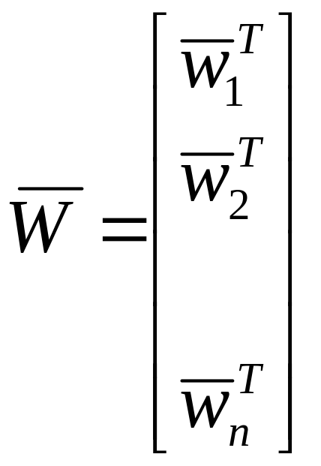
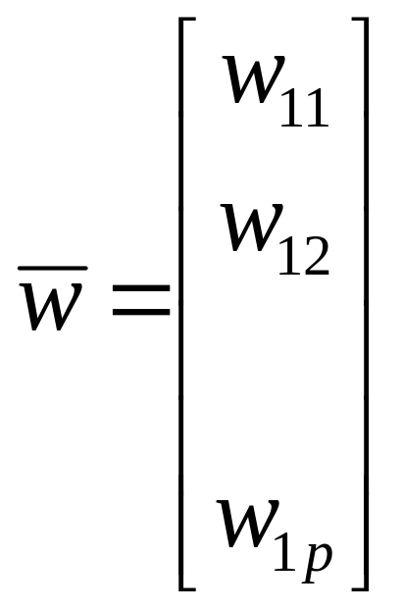
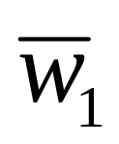
Kohonen Net
x₁
x₂
x_{p}
Neuron n
Neuron 1
M. A. El-Sharkawi, NN-General

